Slide 1
Chapter 2
Introduction to Big Data

Slide 2
Learning Objectives and Learning Outcomes
Learning Objectives | Learning Outcomes
Introduction to big data Definition of big data. Challenges of big data. Why big data? Traditional Business Intelligence versus big data. | To understand the significance of big data. To understand the other characteristics of data that are not definitional characteristics of big data. To understand the challenges of big data and how to deal with the same. To understand what is new today.

Slide 3
Session Plan
Lecture time 45 to 60 minutes
Q/A 15 minutes

Slide 4
Agenda
Definition of Big Data
Volume
Velocity
Variety
Challenges of Big Data
Other Characteristics of Data Which are Not Definitional Traits of Big Data
Why Big Data?
Traditional Business Intelligence (BI) versus Big Data
A Typical Data Warehouse Environment
A Typical Hadoop Environment
Coexistence of Big Data and Data Warehouse

Slide 5
Definition of Big Data

Slide 6
Definition of Big Data
High-volume
High-velocity
High-variety
Cost-effective, innovative forms of information processing
Enhanced insight & decision making
Big Data is high-volume, high-velocity, and high-variety information assets that demand cost effective, innovative forms of information processing for enhanced insight and decision making.
Source: Gartner IT Glossary

Slide 7
Volume - A Mountain of Data

Slide 8
Velocity
Batch → Periodic → Near real time → Real-time processing

Slide 9
Variety
Structured data: example: traditional transaction processing systems and RDBMS, etc.
Semi-structured data: example: Hyper Text Markup Language (HTML), eXtensible Markup Language (XML).
Unstructured data: example: unstructured text documents, audio, video, email, photos, PDFs, social media, etc.

Slide 10
Other Characteristics of Data – Which are not Definitional Traits of Big Data
Veracity and Validity
Volatility
Variability
Notes:
Veracity refers to biases, noise, and abnormality in data.
Volatility of data deals with, how long is the data valid?
Data flows can be highly inconsistent with periodic peaks.

Slide 11
Challenges with Big Data

Slide 12
Challenges with Big Data

Slide 13
Sources of Big Data

Slide 14
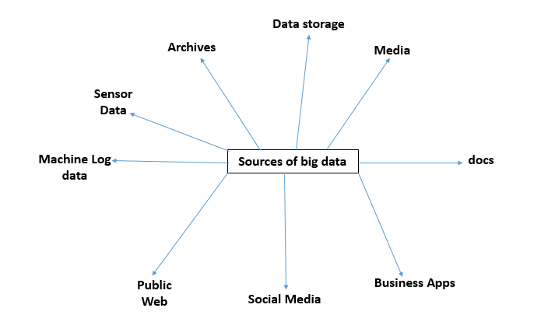
Sources of Big Data
Notes:
There are a multitude of sources for big data. An XLS, a DOC, a PDF … is unstructured data, a video on YouTube, a chat conversation on Internet Messenger, a customer feedback form on an online retail website … is unstructured data, a CCTV coverage, a weather forecast report is unstructured data too.

Slide 15
Why Big Data?

Slide 16
Why Big Data?

Slide 17
Traditional Business Intelligence (BI) versus Big Data
Notes:
In traditional BI environment, data resides in a central server whereas in big data environment, data resides in a distributed file system.
Traditional BI → Move data to code
Big Data Environment → Move code to data
In traditional BI environment, data is analyzed in offline mode whereas in big data environment data is analyzed in both real time as well as offline mode.

Slide 18
A Typical Data Warehouse Environment
Notes:
In a typical DW environment, data is collected from multiple disparate sources, integrated, cleansed and transformed before loading it to a data warehouse. A host of market leading BI tools can then be used on top of the data warehouse for reporting/dashboarding, ad hoc querying and modeling.

Slide 19
A Typical Hadoop Environment
Notes:
Hadoop takes care of storage and processing using the following:
HDFS (Hadoop Distributed File System) (distributed storage)
MapReduce (distributed processing)

Slide 20
Co-existence of Big Data and Data Warehouse

Slide 21
Answer a few quick questions …

Slide 22
Fill in the blanks
Big data is high-volume, high-velocity, and high-variety information assets that demand ---------------------, ------------------------- forms of information processing for enhanced ----------------------- and --------- -------------------.

Slide 23
Answer Me
Share your understanding of Big Data.
How is traditional BI environment different from the Big Data environment?
Share your experience as a customer on an e-commerce site. Comment on the big data that gets created on a typical e-commerce site.

Slide 24
Summary please…
Ask a few participants of the learning program to summarize the lecture.

Slide 25
References …

Slide 26
Further Readings
Big data for dummies - Judith Hurwitz, Alan Nugent, Fern Halper, Marcia Kaufman
http://en.wikipedia.org/wiki/Big_data
http://www.sas.com/en_us/insights/big-data/what-is-big-data.html
https://www.oracle.com/bigdata/
http://bigdatauniversity.com/

Slide 27
Thank you

